Slide 1

Advice for Presentations
SCM 4350

Slide 2







Why are presentation skills important?
Build Your Brand
Exposure & Network
Leadership Skill
Analyst vs Strategic
Represent Your Organization

Slide 3
Overview
Know you audience
Building a Story
Slide Designs
Presentation Posture

Slide 4
Know your Audience
What is the purpose of presenting?
What is the desired takeaway for your audience?
What can you know about your audience before?
What does your audience want from your presentation?

Slide 5



Report Out Introduction to Direct Manager

Slide 6




Introduction to Closeout Presentation for Rotation Program

Slide 8


Entire Presentation to VP

Slide 9
Presentation Structure – Tell a Story
Introduction
Hook your audience
Thesis Statement
Body Paragraph 1
Evidence that supports thesis
Body Paragraph 2
Body Paragraph 3
Conclusion Paragraph
What is the problem/question?
Argument Overview
Evidence that supports thesis
Evidence that supports thesis
Call to Action
What do you want your audience to walk away with

Slide 10

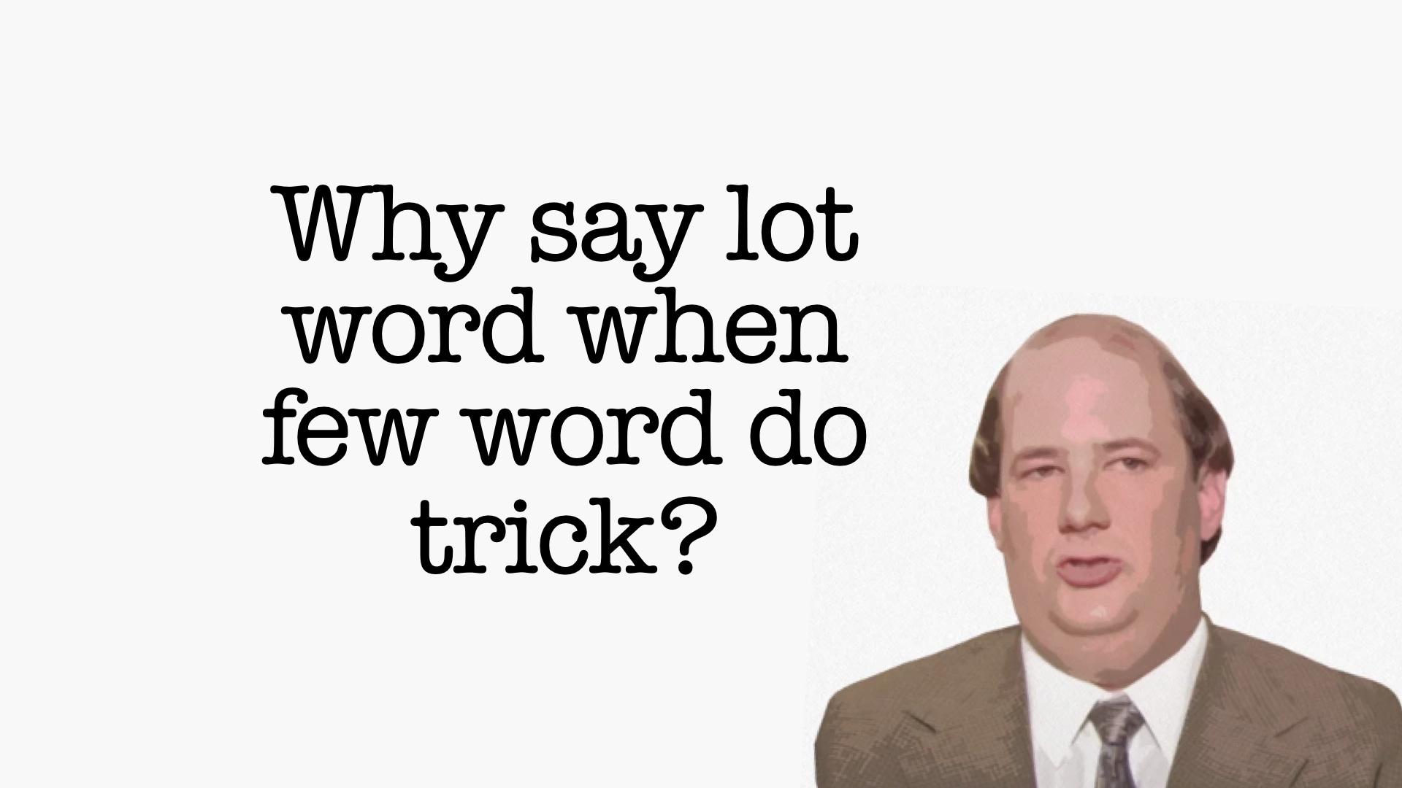
Slide Designs
Slides are Visual Aids
Limit Text
Graphs and Charts
Focused Content
Slides are to help you, not replace you.
Slides are for your audience to better understand what you’re saying.
(please no screenshots of excel data)

Slide 11
Presentation Posture – How Are You Physically Presenting Yourself
 | Virtual | In Person
Eye Contact | Camera | Scan the Room
Body Language | Smaller hand gestures and slower movements | Meaningful hand gestures and movements
Speaking Pace | Speak slower and annunciate more | Mind your pace and project
Spatial Awareness | Prepare your background | Stay open to the audience
Engage with Slides | Use pointer feature to draw attention to slides | Don’t turn your back regularly to read slides
Other General Advice:
Don’t recite a script, it should feel natural and authentic.
If you need more notes to help, use notecards, tablet, etc. Don’t fill your slides with your own cues.
Removing self-view camera can help you stay more present in your virtual presentations.
When presenting in a room, find people who give you helpful cues and make eye contact with them.
Practice presenting to different groups of people.
Record yourself to see your habits and how you can improve.
Practice both types of presentations, you’ll need to be comfortable with both in your career.

